Slide 1
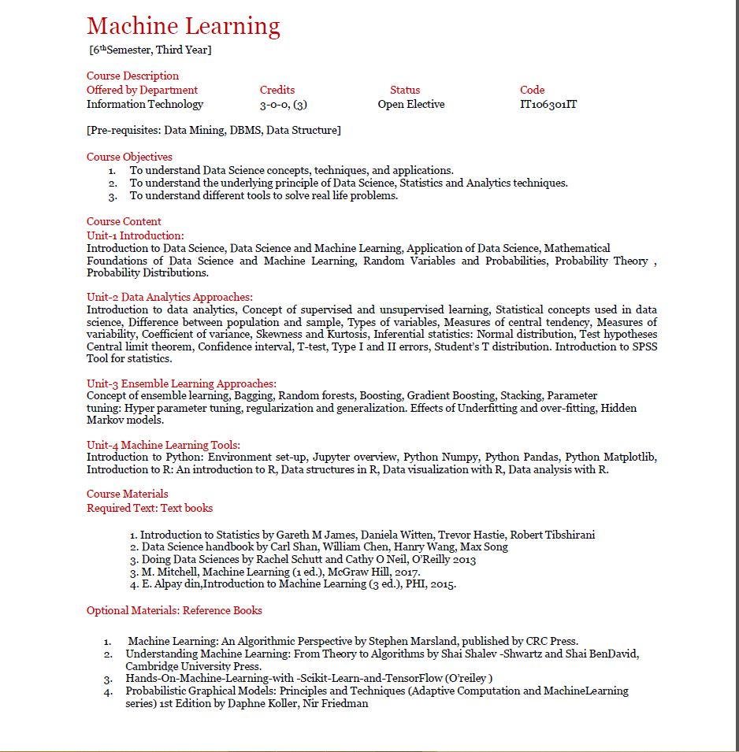

Slide 2
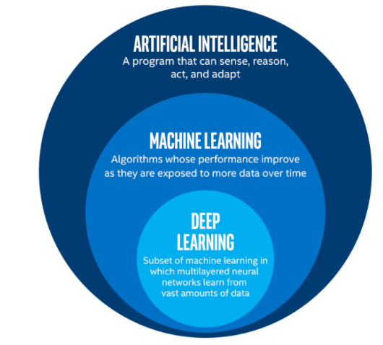

Slide 3
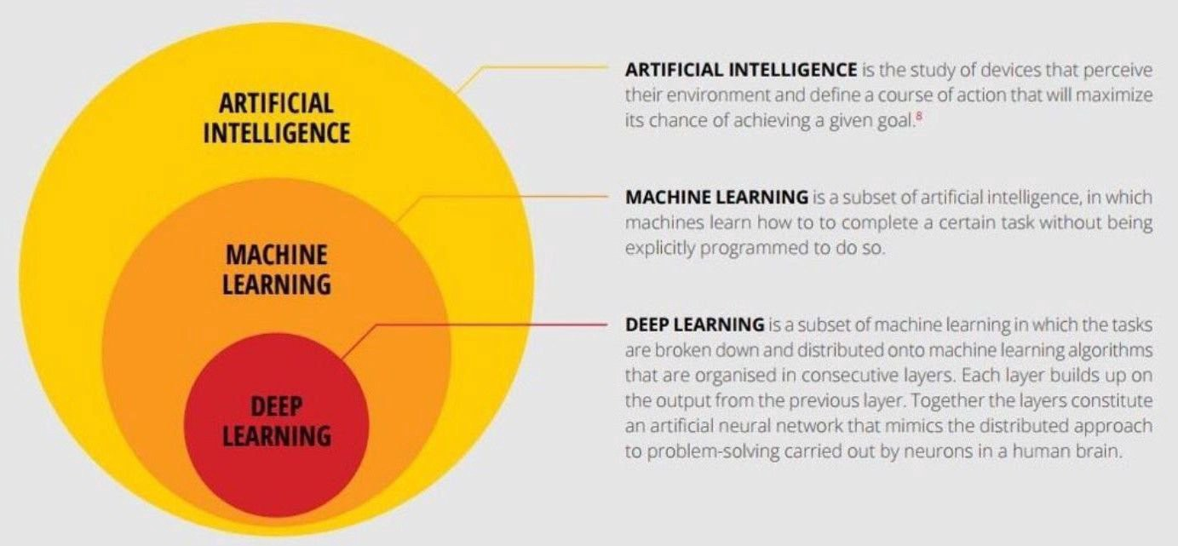

Slide 4
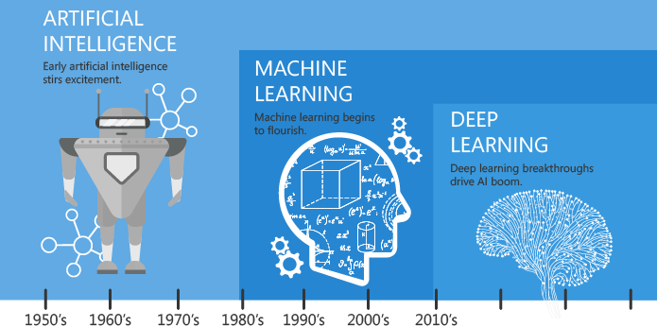

Slide 5
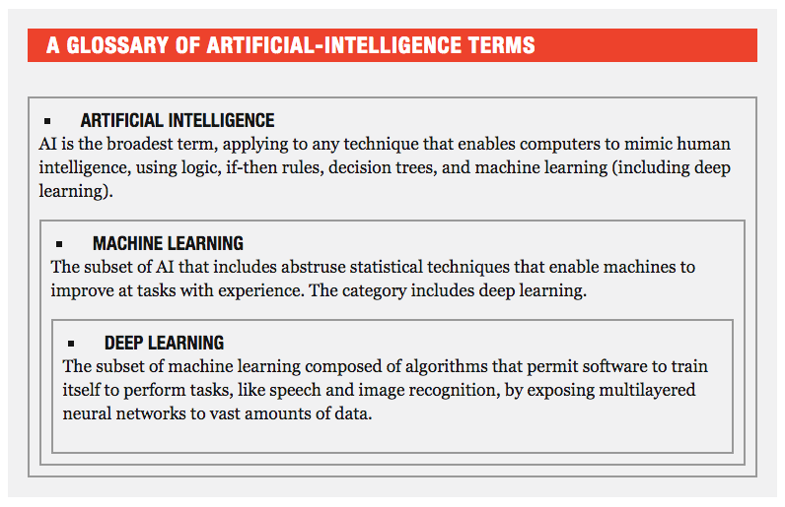

Slide 6
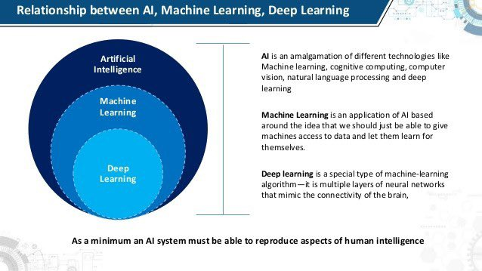

Slide 7
AI Definitions
Understanding the Types of AI Classification
There are numerous terms and definitions in the field of AI which can make it hard to distinguish categories from subsets or types of AI. Since AI research purports to make machines emulate human-like functioning, the degree to which an AI system can replicate human capabilities is used as the criterion for determining the types of AI. Thus, depending on how a machine compares to humans in terms of versatility and performance, AI can be classified under one, among the multiple types of AI. Under such a system, an AI that can perform more human-like functions with equivalent levels of proficiency will be considered as a more evolved type of AI, while an AI that has limited functionality and performance would be considered a simpler and less evolved type.
Based on this criterion, there are two ways in which AI is generally classified. One type is based on classifying AI and AI-enabled machines based on their likeness to the human mind, and their ability to “think” and perhaps even “feel” like humans. According to this system of classification, there are four types of AI or AI-based systems: reactive machines, limited memory machines, theory of mind, and self-aware AI.
We need to overcome the boundaries that define the four different types of artificial intelligence (AI), the barriers that separate machines from us – and us from them.

Slide 8
Reactive Machines perform basic operations. This level of AI is the simplest. These types react to some input with some output. There is no learning that occurs. This is the first stage to any AI system. A machine learning that takes a human face as input and outputs a box around the face to identify it as a face is a simple, reactive machine. The model stores no inputs, it performs no learning.
Limited Memory
Limited memory types refer to an AI’s ability to store previous data and/or predictions, using that data to make better predictions. With Limited Memory, machine learning architecture becomes a little more complex. Every machine learning model requires limited memory to be created, but the model can get deployed as a reactive machine type.
Theory of Mind
We have yet to reach Theory of Mind AI types. AI begins to interact with the thoughts and emotions of humans. Presently, machine learning models do a lot for a person directed at achieving a task. Current models have a one-way relationship with AI. Alexa and Siri bow to every command. If you angrily yell at Google Maps to take you another direction, it does not offer emotional support and say, “This is the fastest direction. Who may I call and inform you will be late?” Google Maps, instead, continues to return the same traffic reports and ETAs that it had already shown and has no concern for your distress.
Self-Awareness
In some distant future, perhaps A.I. achieves nirvana. It becomes self-aware. This kind of A.I. exists only in story, and, as stories often do, instills both immense amounts of hope and fear into audiences. A self-aware intelligence beyond the human has an independent intelligence, and likely, people will have to negotiate terms with the entity it created. What happens, good or bad, is anyone’s guess.

Slide 9
Data science
Data Science has dominated almost all the industries of the world today. There is no industry in the world today that does not use data. As such, data science has become fuel for industries.
There are various industries like banking, finance, manufacturing, transport, e-commerce, education, etc. that use data science. As a result, there are several Data Science Applications related to it. In this article, we will see how data science has transformed the world today.

Slide 10
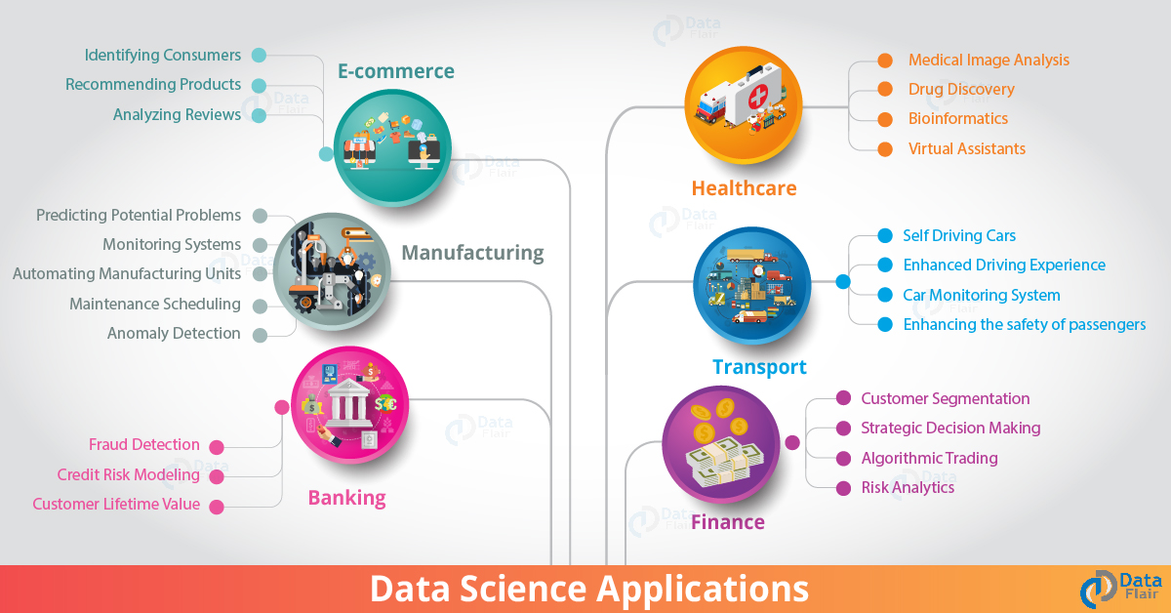

Slide 11
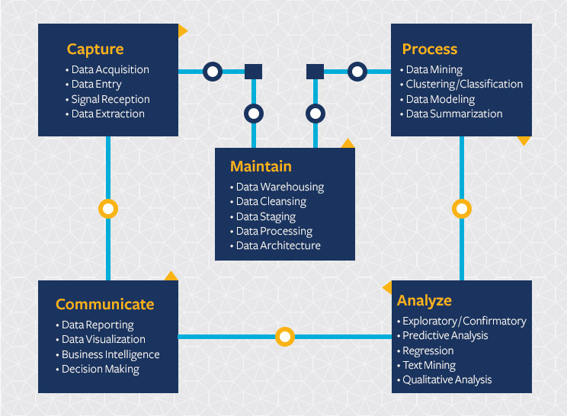

Slide 12
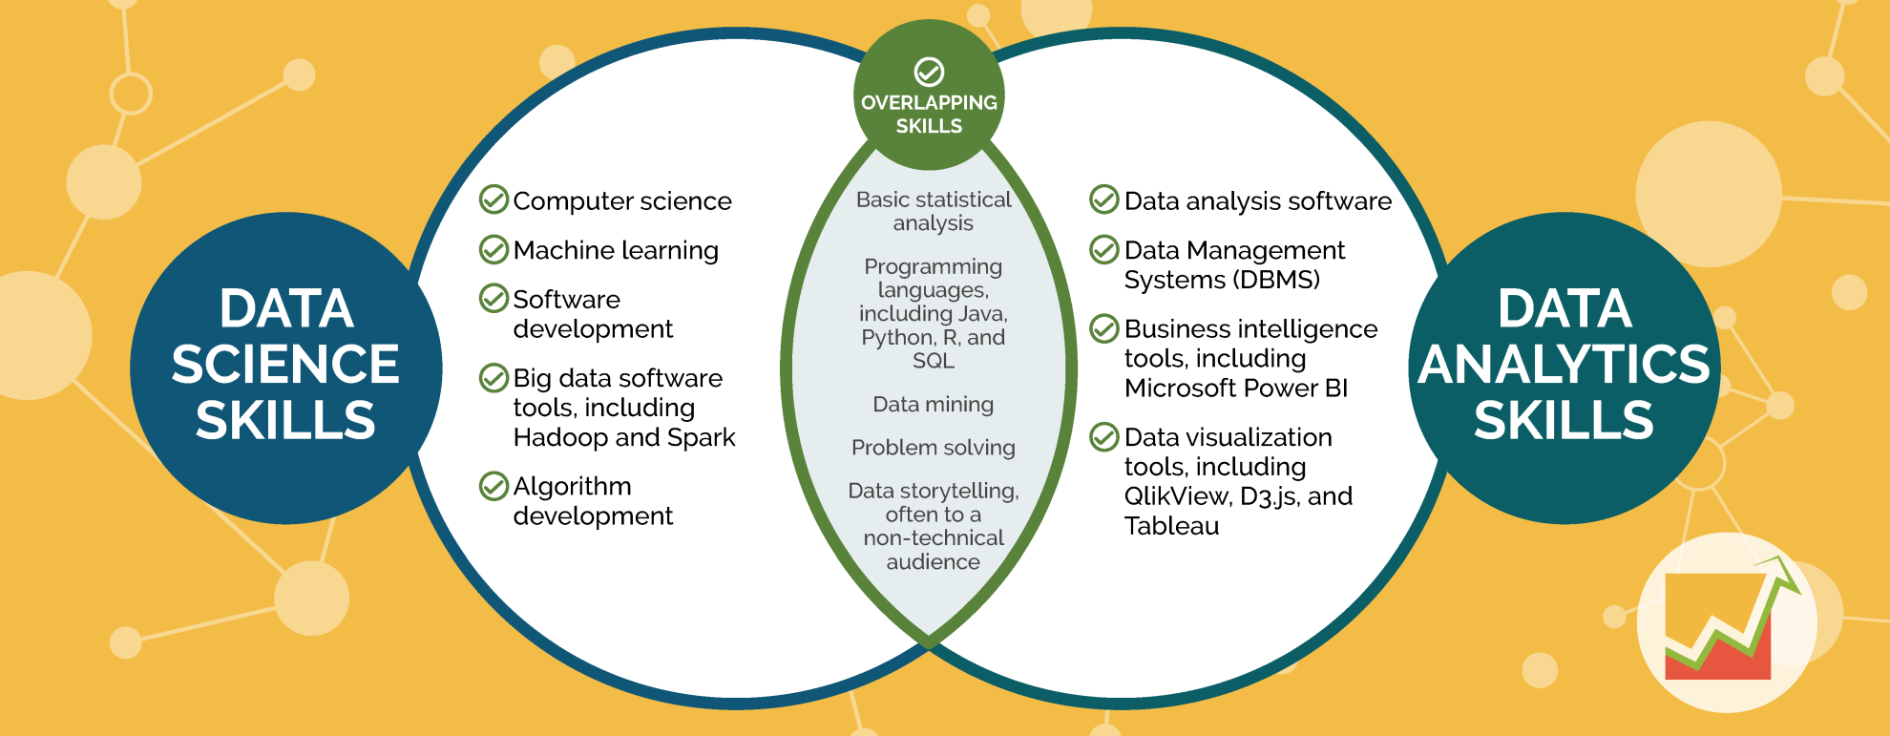

Slide 13
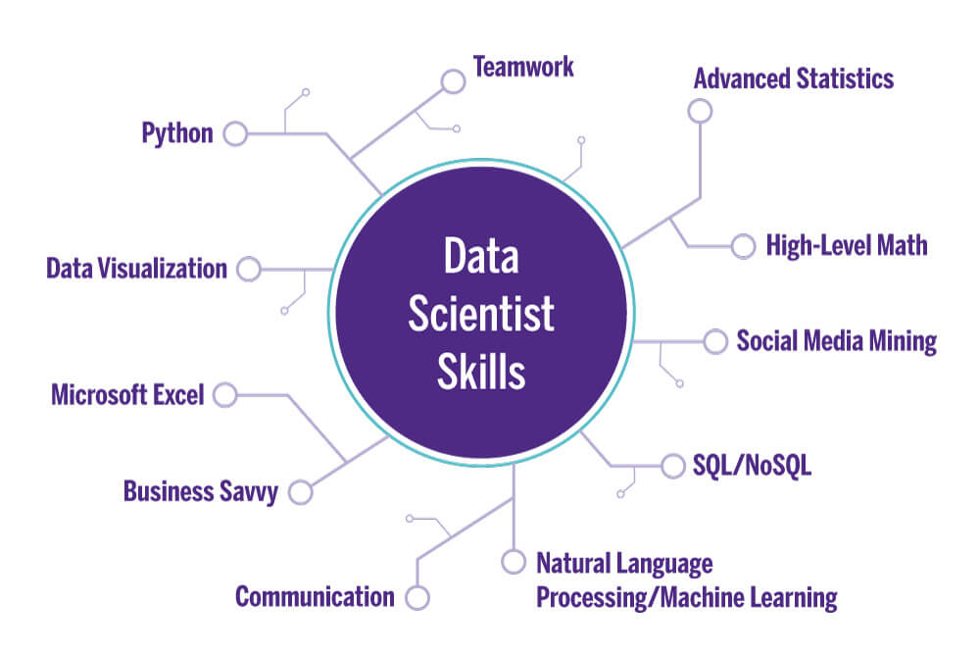

Slide 14
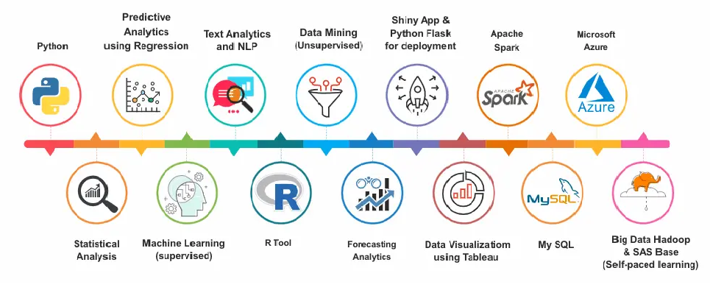

Slide 15
Data Visualization Tools
Data Visualization with tableau is nothing but the process of presenting information through visual rendering.
From centuries back, people have used to visualizations such as charts and maps to understand information more quickly and easily.
As far as the human brain is concerned, it recognizes visual data more quickly than text data.

Slide 16
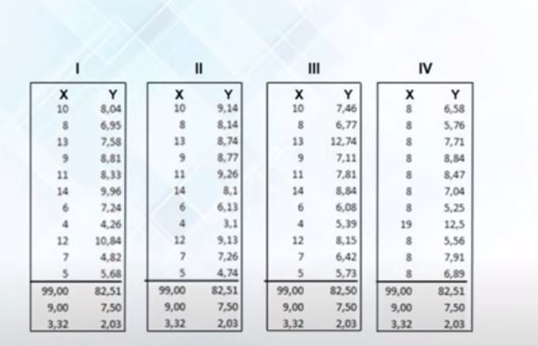

Slide 17
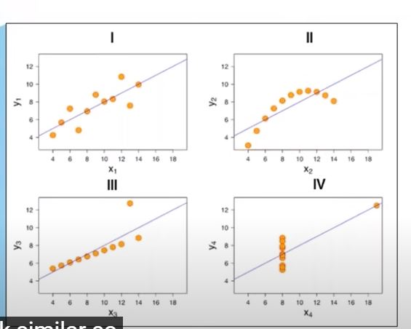

Slide 18
Data Visualization Free Tools
MicroStrategy Analytics Desktop
Domo
Tableau
Qlik View
Looker
Zoho Analytics
Sisense
IBM Cognos Analytics
Qlik Sense
Microsoft Power BI
Klipfolio
SAP Analytics Cloud

Slide 19
Importance of Data Visualization With Tableau
Technological developments in the current scenario have made data visualization more powerful; thus, it improves business intelligence.
There are a lot of reasons why businesses use Data visualization definition. A few are listed down for you.
Visualization helps people to understand things clearly and have a better insight into the topic.
Visualization helps to predict the future easily and take better decisions
Data of large volumes can also be spotted easily and quickly
Data visualization conveys the information in a universal manner
It makes it simple to share ideas with others
Data visualization lets people know where they need to do an adjustment in their business to get a better result.
It provides scalability
It makes interpretation easy

Slide 20

https://www.youtube.com/watch?v=37k9slxNoiM

Slide 21
Tableau
Tableau is a data visualization tool that can be used by data analysts, scientists, statisticians, etc. to visualize the data and get a clear opinion based on the data analysis. Tableau is very famous as it can take in data and produce the required data visualization output in a very short time. And it can do this while providing the highest level of security with a guarantee to handle security issues as soon as they arise or are found by users.
Tableau also allows its users to prepare, clean and format their data and then create data visualizations to obtain actionable insights that can be shared with other users. Tableau is available for the individual data analyst or at scale for business teams and organizations. It provides a 14-day free trial followed by the paid version.

Slide 22
Links for Tableau
https://www.youtube.com/watch?v=jEgVto5QME8
https://www.youtube.com/watch?v=37k9slxNoiM
https://www.youtube.com/watch?v=WAXfRAI96YA

Slide 23
Top R Libraries for Data Visualization
1. ggplot2
2. Plotly
3. Esquisse
4. Lattice
5. RGL
6. Dygraphs
7. Leaflet

Slide 24
Top 8 Python Libraries for Data Visualization
1. Matplotlib
2. Plotly
3. Seaborn
4. GGplot
5. Altair
6. Bokeh
7. Pygal
8.Geoplotlib

Slide 25
Banking
Banking is one of the biggest applications of Data Science. Big Data and Data Science have enabled banks to keep up with the competition.
With Data Science, banks can manage their resources efficiently, furthermore, banks can make smarter decisions through fraud detection, management of customer data, risk modeling, real-time predictive analytics, customer segmentation, etc.
Banks also assess the customer lifetime value that allows them to monitor the number of customers that they have.
It provides them with several predictions that the business bank will derive through their customers.
In case of fraud detection, banks allow the companies to detect frauds that involve a credit card, insurance, and accounting. Banks are also able to analyze investment patterns and cycles of customers and suggest you several offers that suit you accordingly.
Furthermore, banks have the ability to risk modeling through data science through which they can assess their overall performance.
With Data Science, banks are able to tailor personalized marketing that suits the needs of their clients.
In real-time and predictive analytics, banks use machine learning algorithms to improve their analytics strategy. Furthermore, banks use real-time analytics to understand underlying problems that impede their performance.

Slide 26
Finance
Data Science has played a key role in automating various financial tasks. Just like how banks have automated risk analytics, finance industries have also used data science for this task. Financial industries need to automate risk analytics in order to carry out strategic decisions for the company.
Using machine learning, they identify, monitor and prioritize the risks. These machine learning algorithms enhance cost efficiency and model sustainability through training on the massively available customer data.
Similarly, financial institutions use machine learning for predictive analytics. It allows the companies to predict customer lifetime value and their stock market moves.
Data Science also plays a key role in algorithmic trading. Through rigorous analysis of data, financial institutions are able to make data-driven decisions. It is also playing an important role in making the customer experiences better for the users.
Through extensive analysis of client experience and modification of preferences, financial institutions are able to create a personalized relationship with their customers.
This is further boosted by the real-time analytics of customers which increases the personalization. Through various customer sentiment analysis techniques and machine learning algorithms, we can boost the social media interaction, boost their feedback and analyze customer reviews.
Also, the additional machine learning techniques like natural language processing and data mining have contributed to the transformation of information for smarter governance that helps to increase the profitability of businesses.

Slide 27
3. Manufacturing
In the 21st century, Data Scientists are the new factory workers. That means that data scientists have acquired a key position in the manufacturing industries. Data Science is being extensively used in manufacturing industries for optimizing production, reducing costs and boosting the profits.
Furthermore, with the addition of technologies like the Internet of Things (IoT), data science has enabled the companies to predict potential problems, monitor systems and analyze the continuous stream of data.
Furthermore, with data science, industries can monitor their energy costs and can also optimize their production hours.
With a thorough analysis of customer reviews, data scientists can help the industries to make better decisions and improve the quality of their products. Another important aspect of data science in industries is Automation.
With the help of historical and real-time data, industries are able to develop autonomous systems that are helpful in boosting the production of manufacturing lines. It has taken away the redundant jobs and introduced powerful machines that use machine learning technologies like reinforcement learning.

Slide 28
Transport
Another important application of data science is transport. In the transportation sector, Data Science is actively making its mark in making safer driving environments for the drivers. It is also playing a key role in optimizing vehicle performance and adding greater autonomy to the drivers.
Furthermore, in the transport sector, Data Science has actively increased its manifold with the introduction of self-driving cars.
Through extensive analysis of fuel consumption patterns, driver behavior and active vehicle monitoring, data science has created a strong foothold in the transport industry. The self-driving cars the most trending topics in the world today.
With the introduction of autonomy to vehicles through reinforcement learning, vehicle manufacturers are able to create intelligent automobiles. Furthermore, industries can create better logistical routes with the help of data science.
Using a variety of variables like consumer profile, location, economic indicators, and logistics, vendors can optimize delivery routes and provide a proper allocation of resources.
Also, various transportation companies like Uber is using data science for price optimization and providing better experiences to their customers. Using powerful predictive tools, they accurately predict the price based on parameters like a weather pattern, availability of transport, customers, etc.
Must Read – Data Science Tools for Small Business

Slide 29
5. Healthcare
In the health-care industry, data science is making great leaps. The various industries in health-care making use of data science are
Medical Image Analysis
Genetics and Genomics
Drug Discovery
Predictive Modeling for Diagnosis
Health bots or virtual assistants

Slide 30
Medical Image Analysis
In the medical image analysis, data science has created a strong sphere of influence for analyzing medical images such as X-rays, MRIs, CT-Scans, etc. Previously, doctors and medical examiners would have to manually search for clues in the medical images.
However, with the advancements in computing technologies and surge in data, it is possible to create machines that can automatically detect flaws in the imagery.
Data Scientists have created powerful image recognition tools that allow doctors to have an in-depth understanding of complex medical imagery.

Slide 31
Genomic Data Science
Genomic Data Science applies the statistical techniques to genomic sequences, allowing the bioinformaticians and geneticists to understand the defects in genetic structures. It is also helpful in classifying diseases that are genetic in nature.
With data science, we can analyze how genes react to varying kinds of medicines. Also, several big data technologies like MapReduce have significantly reduced the processing time for genome sequencing.

Slide 32
Drug Discovery
Another important field making use of data science is drug discovery. In drug discovery, new candidate medicines are formulated. Drug Discovery is a tedious and often complex process.
Data Science can help us to simplify this process and provide us with an early insight into the success rate of the newly discovered drug. With Machine Learning, we can also analyze several combinations of drugs and their effect on different gene structure to predict the outcome.

Slide 33
Predictive Modeling for Diagnosis
With the advancements in predictive modeling, data scientists can help to predict the outcome of disease given the historical data of the patients.
Data Science has enabled practitioners to analyze the data, make correlations between the variables of the data and also provide insights to doctors and medical practitioners.

Slide 34
Natural Language Processing
Natural Language Processing is a technology of data science that is focused on the analysis of textual information. Using NLP, we can create intelligent bots that answer to user queries.
The application of this can be extended to the healthcare sector where we can create bots that answer questions of patients and provide them with proper diagnostic guidelines.

Slide 35
E-Commerce
E-commerce and retail industries have been hugely benefitted by data science. Some of the ways in which data science has transformed the e-commerce industries are-
For identifying a potential customer base, data science is being heavily utilized.
Usage of predictive analytics for forecasting the goods and services.
Data Science is also used for identifying styles of popular products and predicting their trends.
With data science, companies are optimizing their pricing structures for their consumers.
Data Science is also being heavily used in collaborative filtering, where it forms the backbone of advanced recommendation system. Using this technique, the e-commerce platforms are able to provide insights to the customers based on their historical purchases and purchases made by people of the same style. These type of hybrid recommendation systems, consisting of both collaborative and content-based filtering are helping the industries to provide better services to their customers.
Also, companies are making use of sentiment analysis to analyze the feedbacks provided by the customers. This makes use of natural language processing to analyze texts and online surveys.
Fraud Detection, which is the central role of machine learning in industries is tailored for finding fraud merchants and frauds in wire-transfers.

Slide 36
Skills and Tools You’ll Need in Data Science and Data Analytics

